Slide 1
Microsoft ADO.NET
Continuous staff improvement
ION GANDRABURA

Slide 2
OBjectives
What is ADO.NET
ADO.NET Architecture
SQLConnection
SqlCommand
Query Parametrization
Datatable
DataColumn
DataRow
Dataset
Dataadapter

Slide 3
What is ADO.NET
ADO.NET is a family of technologies that allows .NET developers to interact with data in standard, structured and primarily disconnected ways.
ADO.NET, expressed through the System.Data namespaces, implements a small set of libraries that makes consuming and manipulating large amounts of data simple and straightforward
ADO.NET manages both internal data - data created in memory and used solely within an application - and external data - data housed in a storage apart from the application, such as in a relational database or text file
When communicating with external data stores, ADO.NET presents a disconnected data experience.

Slide 4
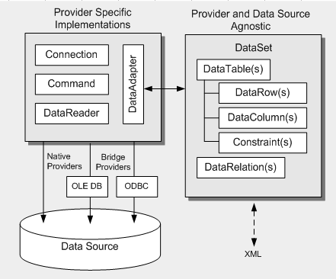
ADO.NET Architecture
Main components : Connection, Command, DataReader, DataAdapter, DataSet, DataView

Slide 5
SQLConnection
SqlConnection - Represents an open connection to a SQL Server database
A SqlConnection object represents a unique session to a SQL Server data source. With a client/server database system, it is equivalent to a network connection to the server
Each SqlConnection requires ConnectionString
If the SqlConnection goes out of scope, it won't be closed. To ensure that connections are always closed, open the connection inside of a using block
ConnectionString can be passed directly to SqlConnection constructor or read from connectionString section of config file.

Slide 6
SQLConnection
ConnectionString from config file
Opening SqlConenction
<connectionStrings>
<add name="demoDB" connectionString="Data Source=.;Initial Catalog=demoDB;Persist Security Info=True;User ID=sa;Password=1"/>
</connectionStrings>
string connectionString = ConfigurationManager.ConnectionStrings["demoDB"].ConnectionString;
using (var sqlConnection = new SqlConnection(connectionString))
{
sqlConnection.Open();
// use sqlConnection
}

Slide 7
SqlCommand
Represents a Transact-SQL statement or stored procedure to execute against a SQL Server database
Both DDL and DML statements can be processed through SqlCommand
SQL statement to which it needs to be executed by SqlCommand is stored in CommandTextProperty
SqlCommand provides 3 ways of query execution:
ExecuteNonQuery – executes SQL statement without returning any results
ExecuteScalar – executes SQL statement returning scalar value
ExecuteReader – executes SQL statement and returns SqlDataReader which allows read rows

Slide 8
SqlCommand
ExecuteNonQuery example
using (var sqlConnection = new SqlConnection(connectionString))
{
sqlConnection.Open();
var sqlCommandText = "CREATE TABLE Users(userId int not null identity(1,1) primary key, name NVARCHAR(255))";
using(var sqlCommand=new SqlCommand(sqlCommandText, sqlConnection))
{
sqlCommand.ExecuteNonQuery();
}
}

Slide 9
SqlCommand
ExecuteScalar example
using (var sqlConnection = new SqlConnection(connectionString))
{
sqlConnection.Open();
var sqlCommandText = "SELECT COUNT(*) FROM Users;";
using(var sqlCommand=newSqlCommand(sqlCommandText, sqlConnection))
{
var count = sqlCommand.ExecuteScalar();
}
}

Slide 10
SqlCommand
ExecuteReader example
using (var sqlConnection = new SqlConnection(connectionString))
{
sqlConnection.Open();
var sqlCommandText = "SELECT * FROM Users;";
using(var sqlCommand=new SqlCommand(sqlCommandText, sqlConnection))
{
SqlDataReader usersReader = sqlCommand.ExecuteReader();
while (usersReader.Read())
{
int id = (int)usersReader["userId"];
string name = (string)usersReader["name"];
Console.WriteLine("User Id={0}, Name={1}", id, name);
}
}
}

Slide 11
Query Parametrization
By creating relevant parameters and attaching them to SqlCommand instances, ordinary text queries become parameterized queries
Protects against SQL injection attack
Parameterization provides for more generic command text, and a logically separation between the command and its data
Removing ever-changing data values from SQL statements also increases performance within SQL server

Slide 12
Query Parametrization
using (var sqlConnection = new SqlConnection(connectionString))
{
sqlConnection.Open();
var sqlCommandText = "SELECT * FROM Users WHERE userId=@id;";
using(var sqlCommand=new SqlCommand(sqlCommandText, sqlConnection))
{
sqlCommand.Parameters.Add("@id", SqlDbType.Int);
sqlCommand.Parameters["@id"].Value = 2;
SqlDataReader usersReader = sqlCommand.ExecuteReader();
while (usersReader.Read())
{
int id = (int)usersReader["userId"];
string name = (string)usersReader["name"];
Console.WriteLine("User Id={0}, Name={1}", id, name);
}
}
}

Slide 13
Datatable
A DataTable represents one table of in-memory relational data; the data is local to the .NET-based application in which it resides
The three main classes that make up a data table are DataTable, DataColumn and DataRow
Example
DataTable unNamedTable = new DataTable();
DataTable usersTable = new DataTable("Users");

Slide 14
DataTable - DataColumn
Each table contains at least one column
Columns defines the table structure
Columns in DataTable are represented by DataColumn found in System.Data namespace
Each column is defined by its Name and type
DataTable stores columns in Columns property
Example
DataTable usersTable = new DataTable("Users");
DataColumn idColumn = new DataColumn("Id", typeof(int));
usersTable.Columns.Add(idColumn);
usersTable.Columns.Add("name", typeof(string));

Slide 15
DataTable - Datarow
Rows represents the actual data registrations in table
Each row in DataTable is represented by DataRow class from System.Data namespace
The DaraRow class lets you store a single row of data in a table
The DataTable class includes the NewRow method to generate table specific rows
Example
DataTable usersTable = new DataTable("Users");
usersTable.Columns.Add("Id", typeof(int));
usersTable.Columns.Add("name", typeof(string));
DataRow row1 = usersTable.NewRow();
row1["Id"] = 1;
row1["name"] = "John";
usersTable.Rows.Add(row1);

Slide 16
Dataset
The DataSet, which is an in-memory cache of data retrieved from a data source, is a major component of the ADO.NET architecture
The DataSet consists of a collection of DataTable objects that you can relate to each other with DataRelation objects
Whereas DataTable objects contain the data, the DataRelationCollection allows you to navigate though the table hierarchy
Example
DataSet dataSet = new DataSet("myDb");
dataSet.Tables.Add("Customers");
dataSet.Tables.Add("Orders");
dataSet.Relations.Add("CustOrders",
dataSet.Tables["Customers"].Columns["CustomerId"],
dataSet.Tables["Orders"].Columns["CustomerId"]
);

Slide 17
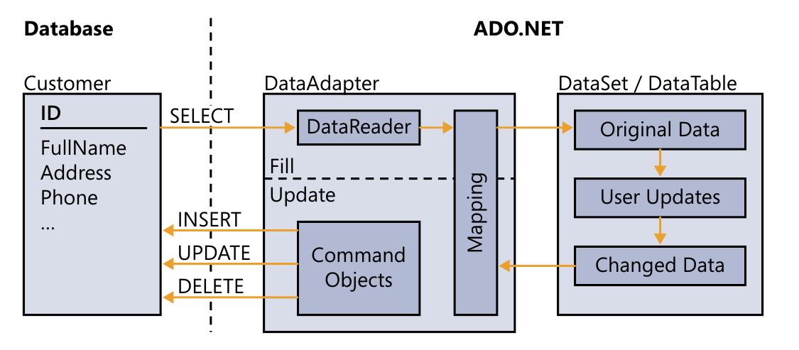
Dataadapter
Data adapters link your external database tables and your local DataSet-managed tables by issuing SQL statements
When DataSet needs to be populated with data from database the DataAdapter issue SELECT statement
When changes from DataSet needs to be stored in database DataAdapter performs INSERT, UPDATE and DELETE statements

Slide 18
Dataadapter – Commands
DataAdapter contains 4 commands which allows data manipulation
SqlDataAdapter.SelectCommand property manages the movement of data from the external source to the local DataSet or DataTable.
SqlDataAdapter.InsertCommand property manages inserting new rows from the local DataSet or DataTable to external source.
SqlDataAdapter.UpdateCommand property manages updating modified rows from the local DataSet or DataTable to external source.
SqlDataAdapter.DeleteCommand property manages deleting removed rows from the local DataSet or DataTable to external source.

Slide 19
Dataadapter – Select command
SELECT command example
string connectionString = ConfigurationManager.ConnectionStrings["demoDB"].ConnectionString;
var sqlCommandText = "SELECT * FROM Users;";
DataAdapter dataAdapter = new SqlDataAdapter(sqlCommandText,
connectionString);
DataSet dataSet =new DataSet();
dataAdapter.Fill(dataSet);

Slide 20
Dataadapter – INSERT command
SELECT insert example
var insertText = "INSERT INTO Users(name) VALUES(@Name)";
SqlCommand insertCommand = new SqlCommand(insertText, sqlConnection);
insertCommand.Parameters.Add("@Name", SqlDbType.VarChar, 255, "name");
dataAdapter.InsertCommand = insertCommand;
var row = dataTable.NewRow();
row["Name"] = "Oman";
dataTable.Rows.Add(row);
dataAdapter.Update(dataTable);

Slide 21
Assignment
Create Console application, empty Database and add connection string to config file
Write SQLComamnds to create 2 tables
Create dataadapter and define its SELECT, update, insert and delete commands.
Create DataTable, insert new rows into it and push changes DatabAse through dataadapter created in previous step
Manipulate data from Datatable so that dataadapter will use all 4 commands

Slide 22
References
Microsoft ADO.NET 4 Step by Step (Step by Step Developer)
DataSets, DataTables, and DataViews (ADO.NET)

